Slide 1
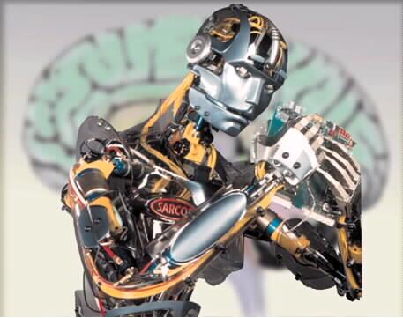

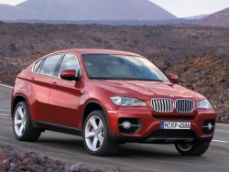


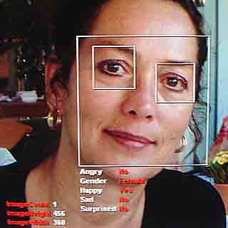
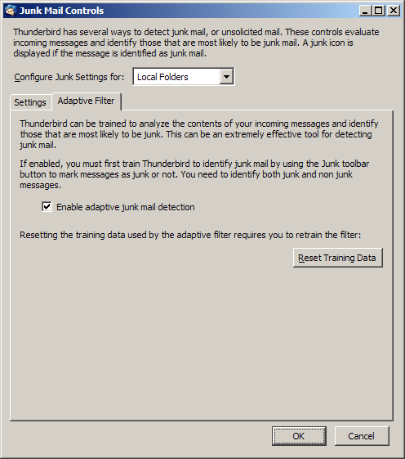

What is Machine Learning?

Slide 2
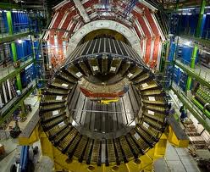
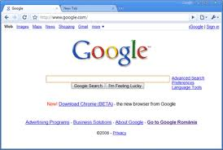
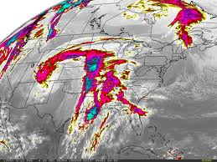
Learning from Data
The world is driven by data.
Germany’s climate research centre generates 10 petabytes per year
Google processes 24 petabytes per day
The Large Hadron Collider produces 60 gigabytes per minute (~12 DVDs)
There are over 50m credit card transactions a day in the US alone.

Slide 3
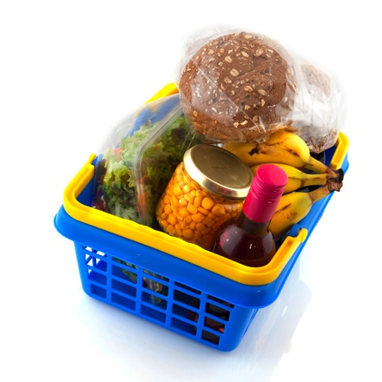

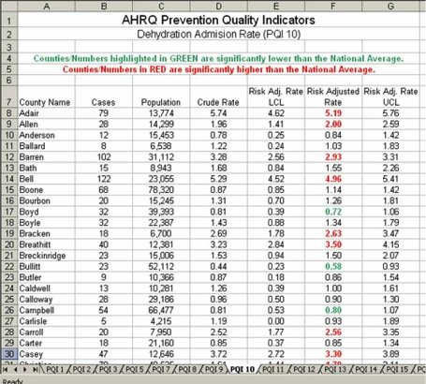
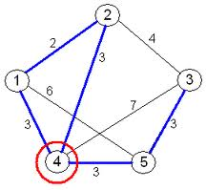
Learning from Data
Data is recorded from some real-world phenomenon.
What might we want to do with that data?
Prediction
- what can we predict about this phenomenon?
Description
- how can we describe/understand this phenomenon in a new way?

Slide 4


Learning from Data
How can we extract knowledge from data to help humans take decisions?
How can we automate decisions from data?
How can we adapt systems dynamically to enable better user experiences?
Write code to explicitly
do the above tasks
Write code to make the computer
learn how to do the tasks

Slide 5
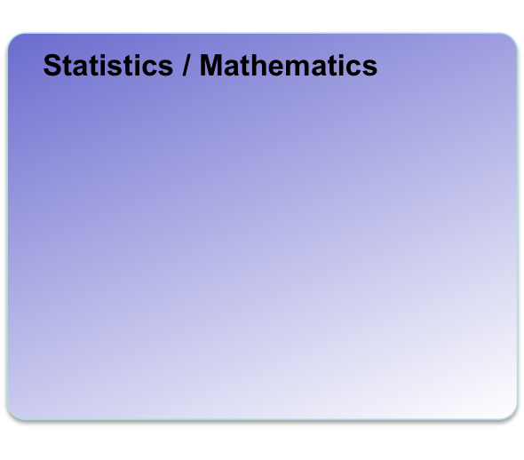
Machine Learning
Where does it fit? What is it not?
Artificial Intelligence
Data Mining
Machine Learning
Computer Vision
Robotics
(No definition of a field is perfect – the diagram above is just one interpretation, mine ;-)

Slide 6
Coding Skills
Maths/Statistics
Knowledge
Machine Learning
Data Science
£££
Software Engineer
Statistician
Specialist Domain Knowledge

Slide 7

Humans can:
- think, learn, see, understand language, reason, etc.
Artificial Intelligence aims to reproduce these capabilities.
Machine Learning is one part of Artificial Intelligence.
COMP14112 Fundamentals of Artificial Intelligence
COMP24111 Introduction to Machine Learning
COMP24412 Symbolic AI
COMP37212 Computer Vision
COMP34512 Knowledge Representation/Reasoning
COMP34411 Natural Language Systems
COMP34120 Artificial Intelligence and Games

Slide 8
Introduction to Machine Learning
http://studentnet.cs.manchester.ac.uk/ugt/COMP24111
50% lab / coursework
- Ex1 (due this week) …. 10%
- Ex2 (due end of Oct) …… 20%
- Ex3 (due end of Nov) ……20%
50% January exam
Programming : Matlab (no experience required)
Maths : A little bit – would help you to revise A-level.
See notes/slides on course website.

Slide 9
Using machine learning to detect spam emails.
To: you@gmail.com
GET YOUR DIPLOMA TODAY!
If you are looking for a fast and cheap way to get a diploma, this is the best way out for you. Choose the desired field and degree and call us right now: For US: 1.845.709.8044 Outside US: +1.845.709.8044 "Just leave your NAME & PHONE NO. (with CountryCode)" in the voicemail. Our staff will get back to you in next few days!
ALGORITHM
Naïve Bayes
Rule mining

Slide 10
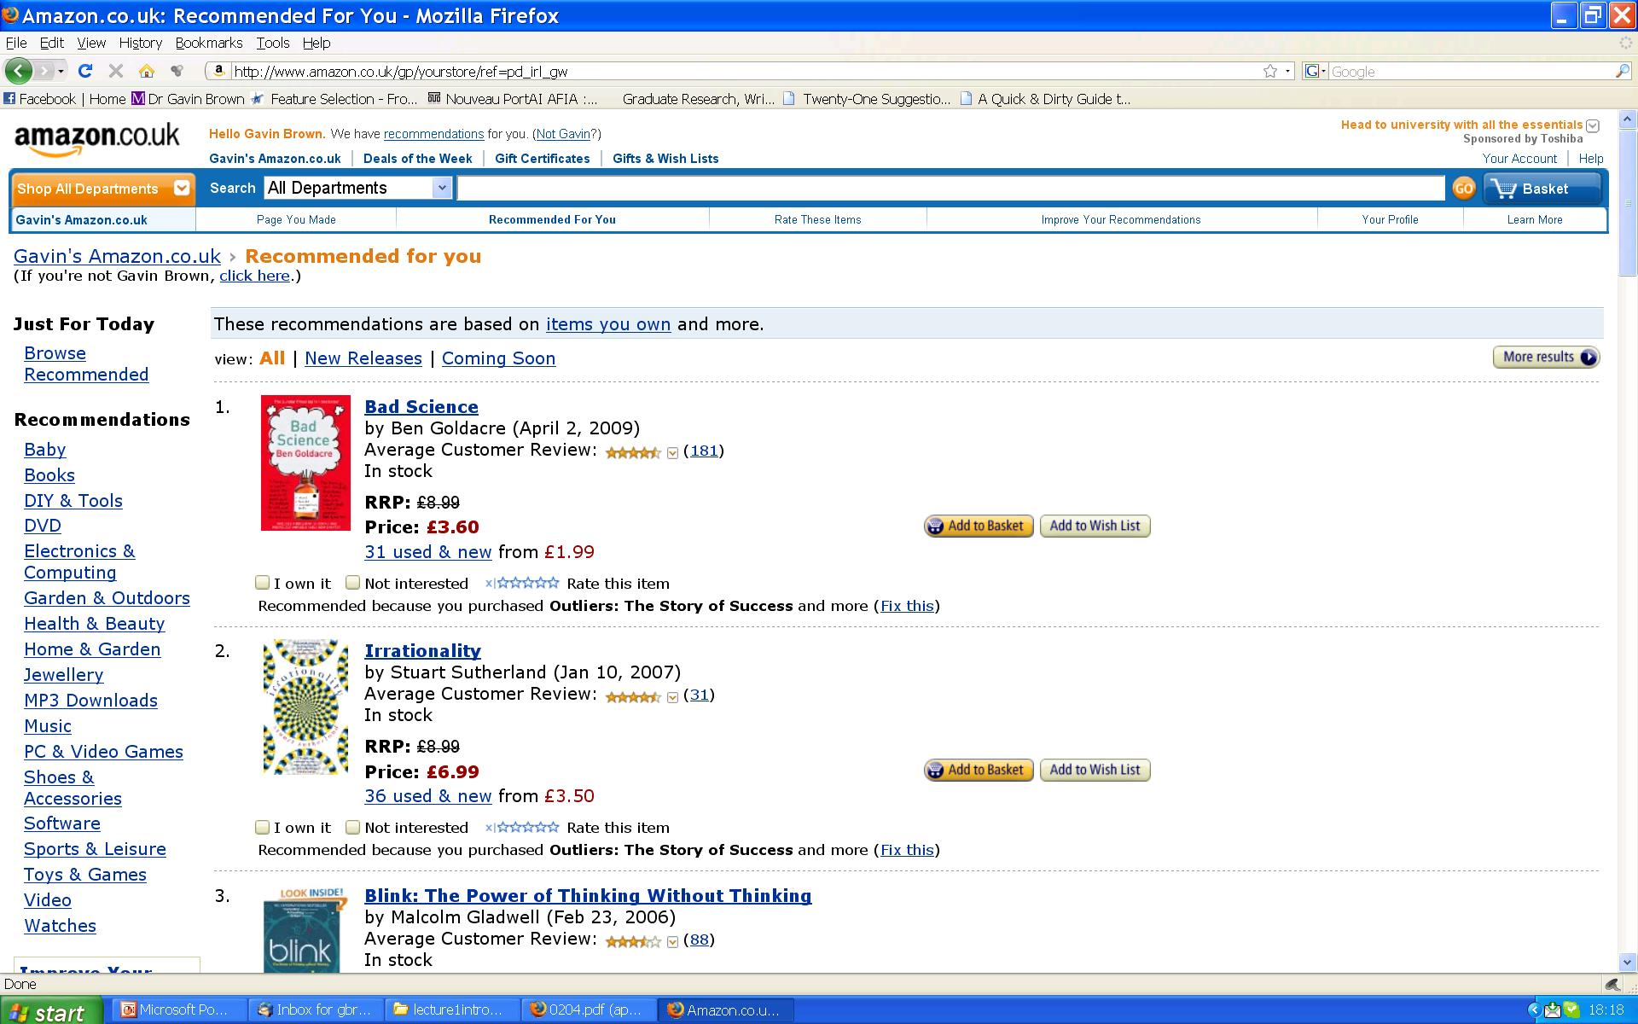
Using machine learning to recommend books.
ALGORITHMS
Collaborative Filtering
Nearest Neighbour
Clustering

Slide 11
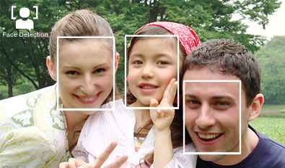
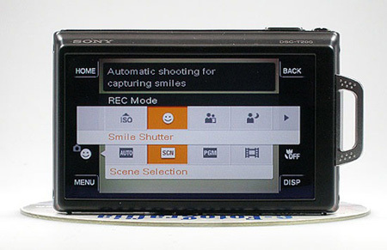
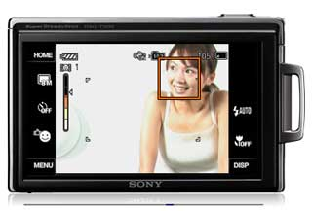
Using machine learning to identify faces and expressions.
ALGORITHMS
Decision Trees
  Adaboost

Slide 12
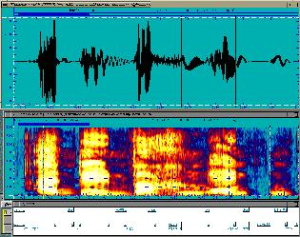
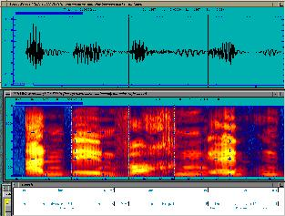
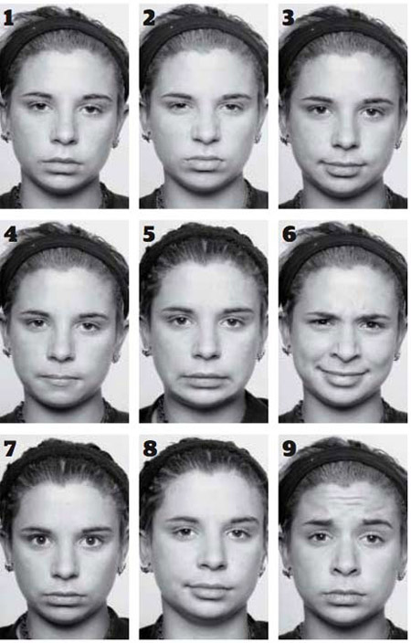
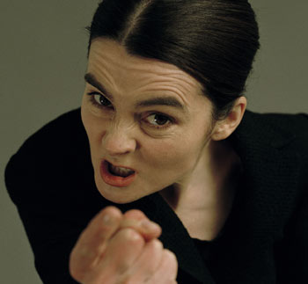
Using machine learning to identify vocal patterns
ALGORITHMS
Feature Extraction
Probabilistic Classifiers
Support Vector Machines
+ many more….

Slide 13
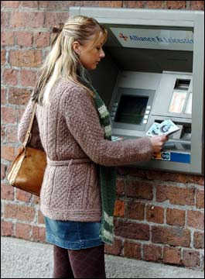
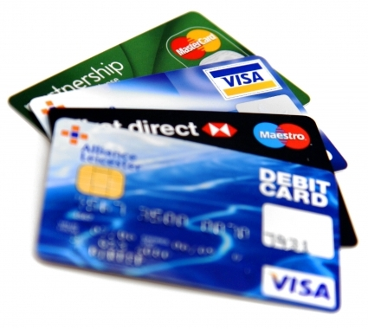

ML for working with social network data: detecting fraud, predicting click-thru patterns, targeted advertising, etc etc etc .
ALGORITHMS
Support Vector Machines
Collaborative filtering
Rule mining algorithms
Many many more….

Slide 14
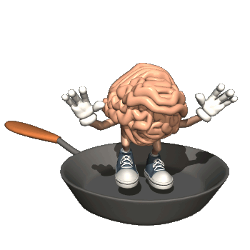
Driving a car
Recognising spam emails
Recommending books
Reading handwriting
Recognising speech, faces, etc
How would you write these programs?
Would you want to?!?!?!?

Slide 15


Many applications are immensely hard to program directly.
These almost always turn out to be “pattern recognition” tasks.
1. Program the computer to do the pattern recognition task directly.
1. Program the computer to be able to learn from examples.
2. Provide “training” data.

Slide 16
Definition of Machine Learning
self-configuring data structures that allow a computer to do things that would be called “intelligent” if a human did it
“making computers behave like they do in the movies”

Slide 17
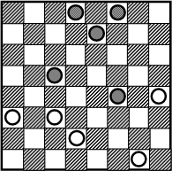
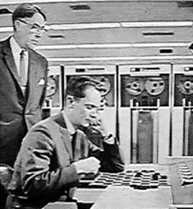
A Bit of History
Arthur Samuel (1959) wrote a program that learnt to play draughts (“checkers” if you’re American).

Slide 18
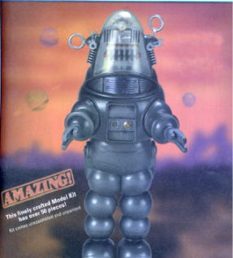
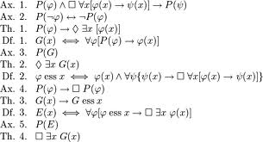
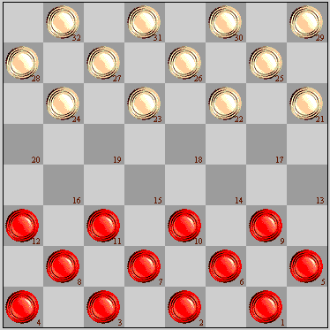
1940s
Human reasoning / logic first studied as a formal subject within mathematics (Claude Shannon, Kurt Godel et al).
1950s
The “Turing Test” is proposed: a test for true machine intelligence, expected to be passed by year 2000. Various game-playing programs built. 1956 “Dartmouth conference” coins the phrase “artificial intelligence”.
1960s
A.I. funding increased (mainly military). Famous quote: “Within a generation ... the problem of creating 'artificial intelligence' will substantially be solved."

Slide 19
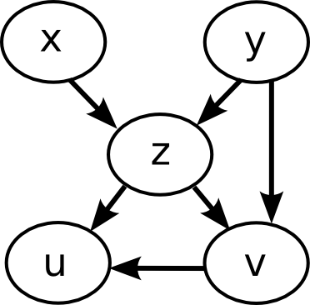
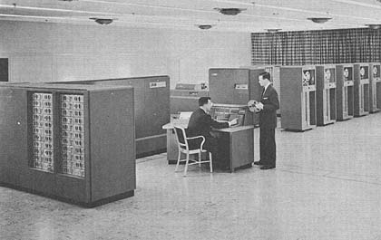
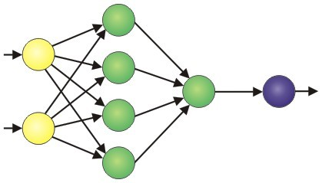

1970s
A.I. “winter”. Funding dries up as people realise it’s hard.
Limited computing power and dead-end frameworks.
1980s
Revival through bio-inspired algorithms: Neural networks, Genetic Algorithms.
A.I. promises the world – lots of commercial investment – mostly fails.
Rule based “expert systems” used in medical / legal professions.
1990s
AI diverges into separate fields: Computer Vision, Automated Reasoning, Planning systems, Natural Language processing, Machine Learning…
…Machine Learning begins to overlap with statistics / probability theory.

Slide 20
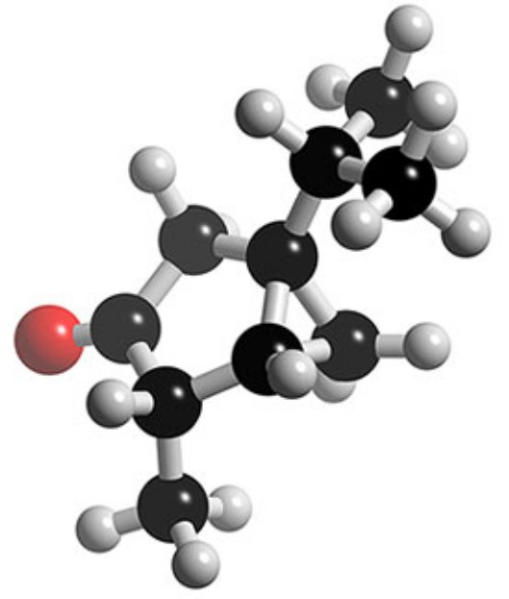
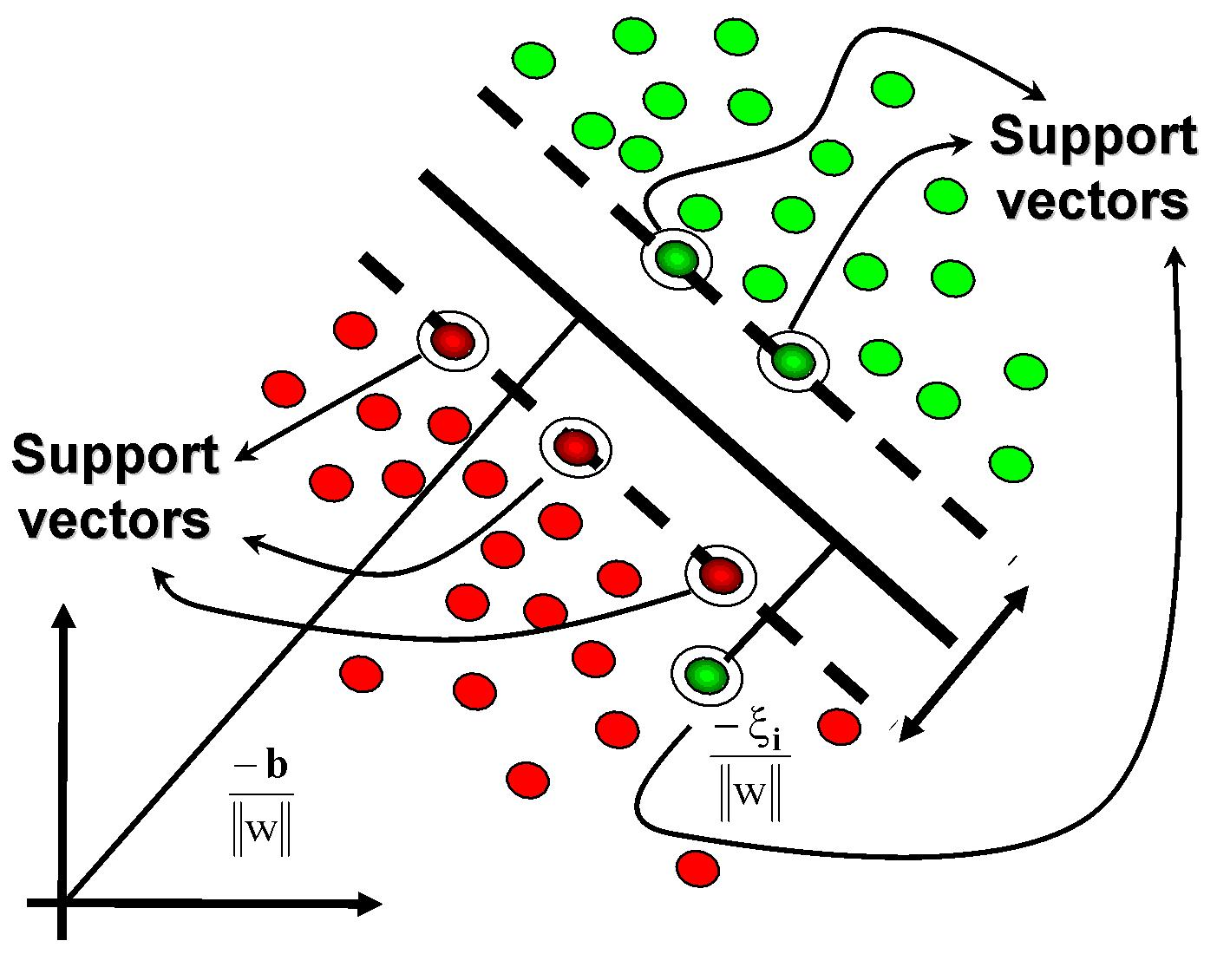
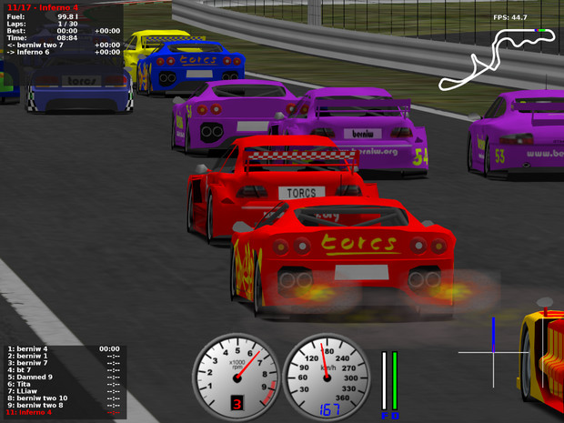
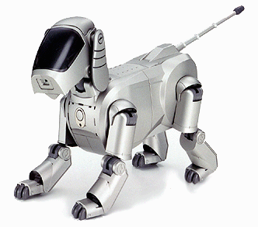
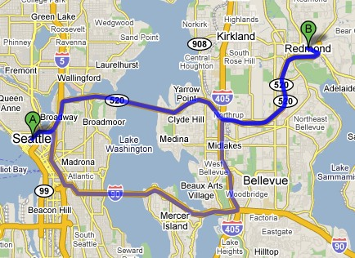
2000s
ML merging with statistics continues. Other subfields continue in parallel.
First commercial-strength applications: Google, Amazon, computer games, route-finding, credit card fraud detection, etc…
Tools adopted as standard by other fields e.g. biology
2010s…. ??????

Slide 21
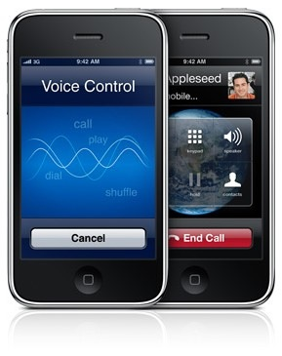
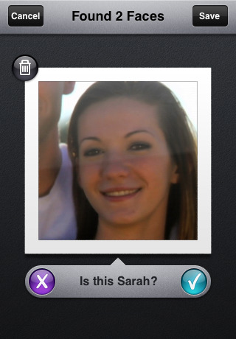
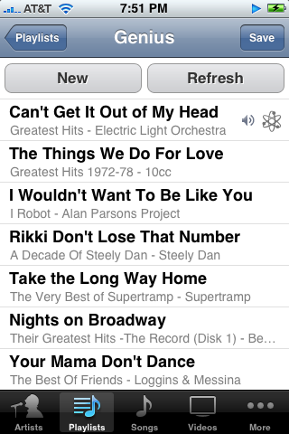
The future?

Slide 22
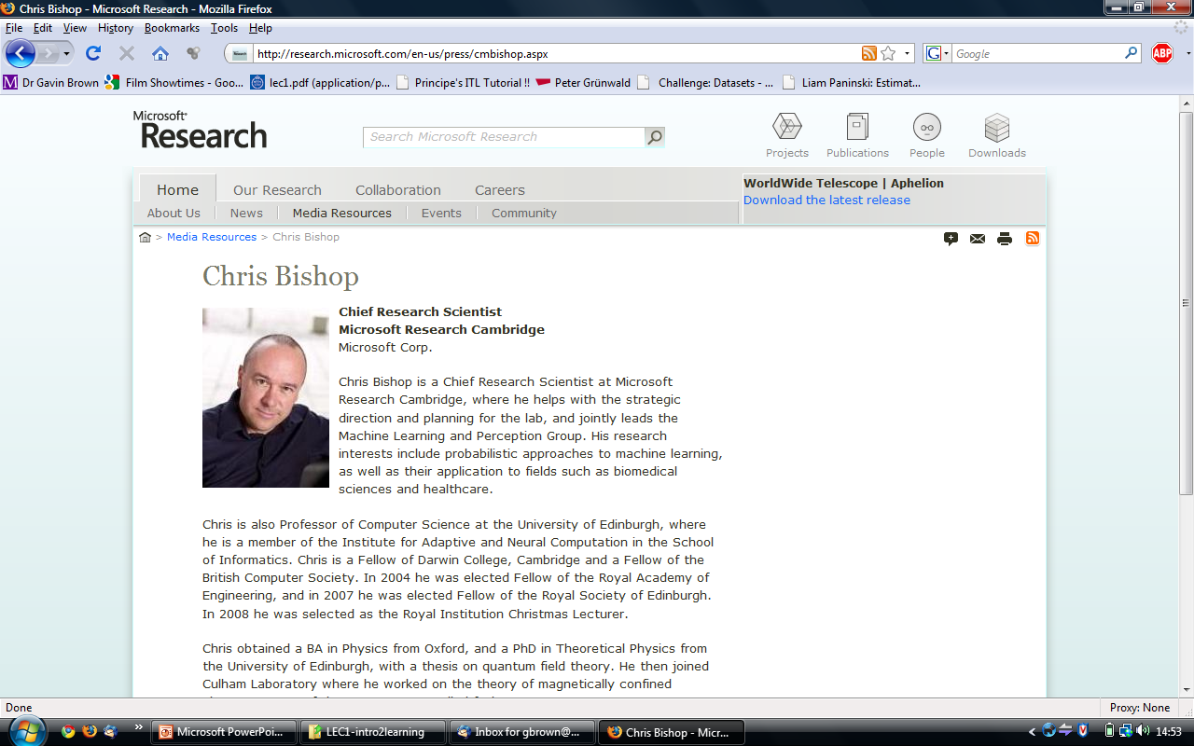
http://www.youtube.com/watch?v=NS_L3Yyv2RI
Microsoft has a MAJOR worldwide investment in Machine Learning

Slide 23
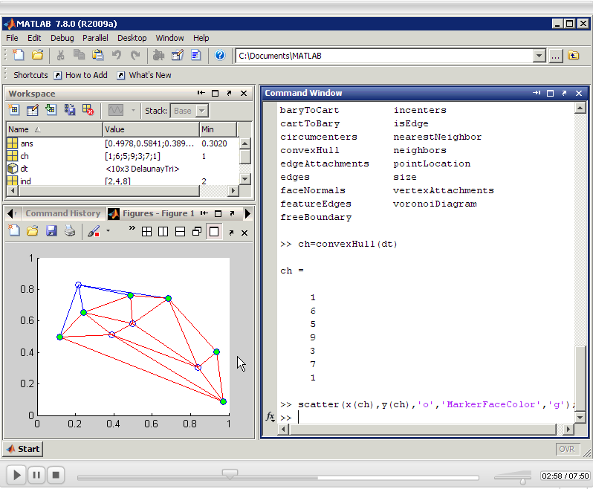
Programming language : “Matlab”
MATrix LABoratory
Interactive scripting language
Interpreted (i.e. no compiling)
Objects possible, not compulsory
Dynamically typed
Flexible GUI / plotting framework
Large libraries of tools
Highly optimized for maths

Slide 24
Introduction to Machine Learning
http://studentnet.cs.manchester.ac.uk/ugt/COMP24111
Now – short break – prompt!
After the break:
Your first machine learning algorithm.

